Slide 1
BP Reservoir Permeability -- Measurements on rock samples for rock permeability
Christian Haller
September 2019

Slide 2
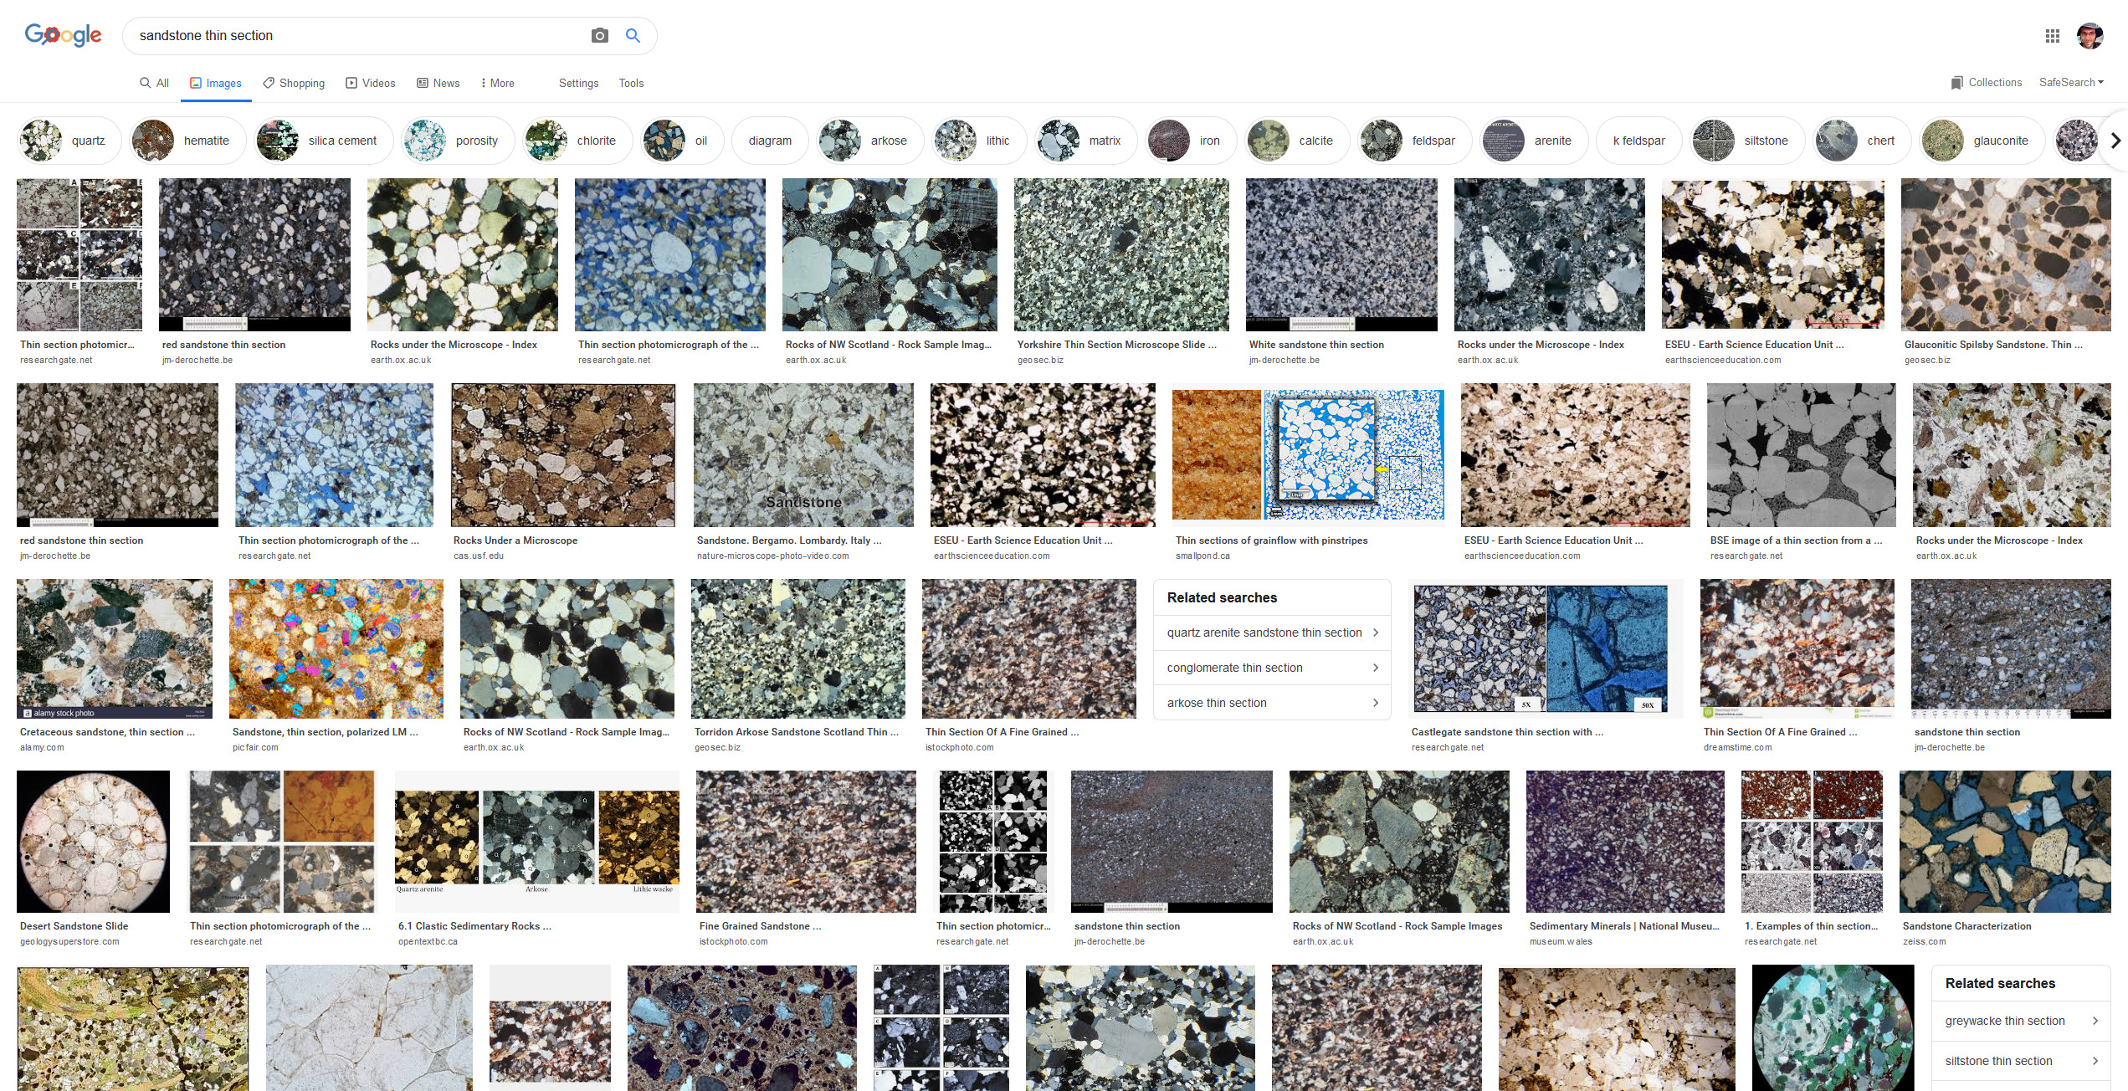
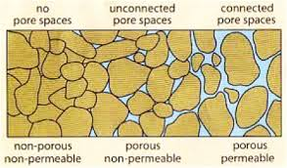
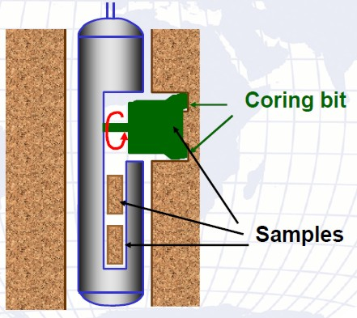

Source: http://www.mssa.org.my/site/images/smy_dec_2015/reservoirs/2015-2.png
Permeability in fluid mechanics and the earth sciences (commonly symbolized as k) is a measure of the ability of a porous material (often, a rock or an unconsolidated material) to allow fluids to pass through it.
The permeability of a medium is related to the porosity, but also to the shapes of the pores in the medium and their level of connectedness.
Source: Crains Petrophysical Handbook Coring And Core Porosity
https://www.spec2000.net/09-coremethods.htm

Slide 3
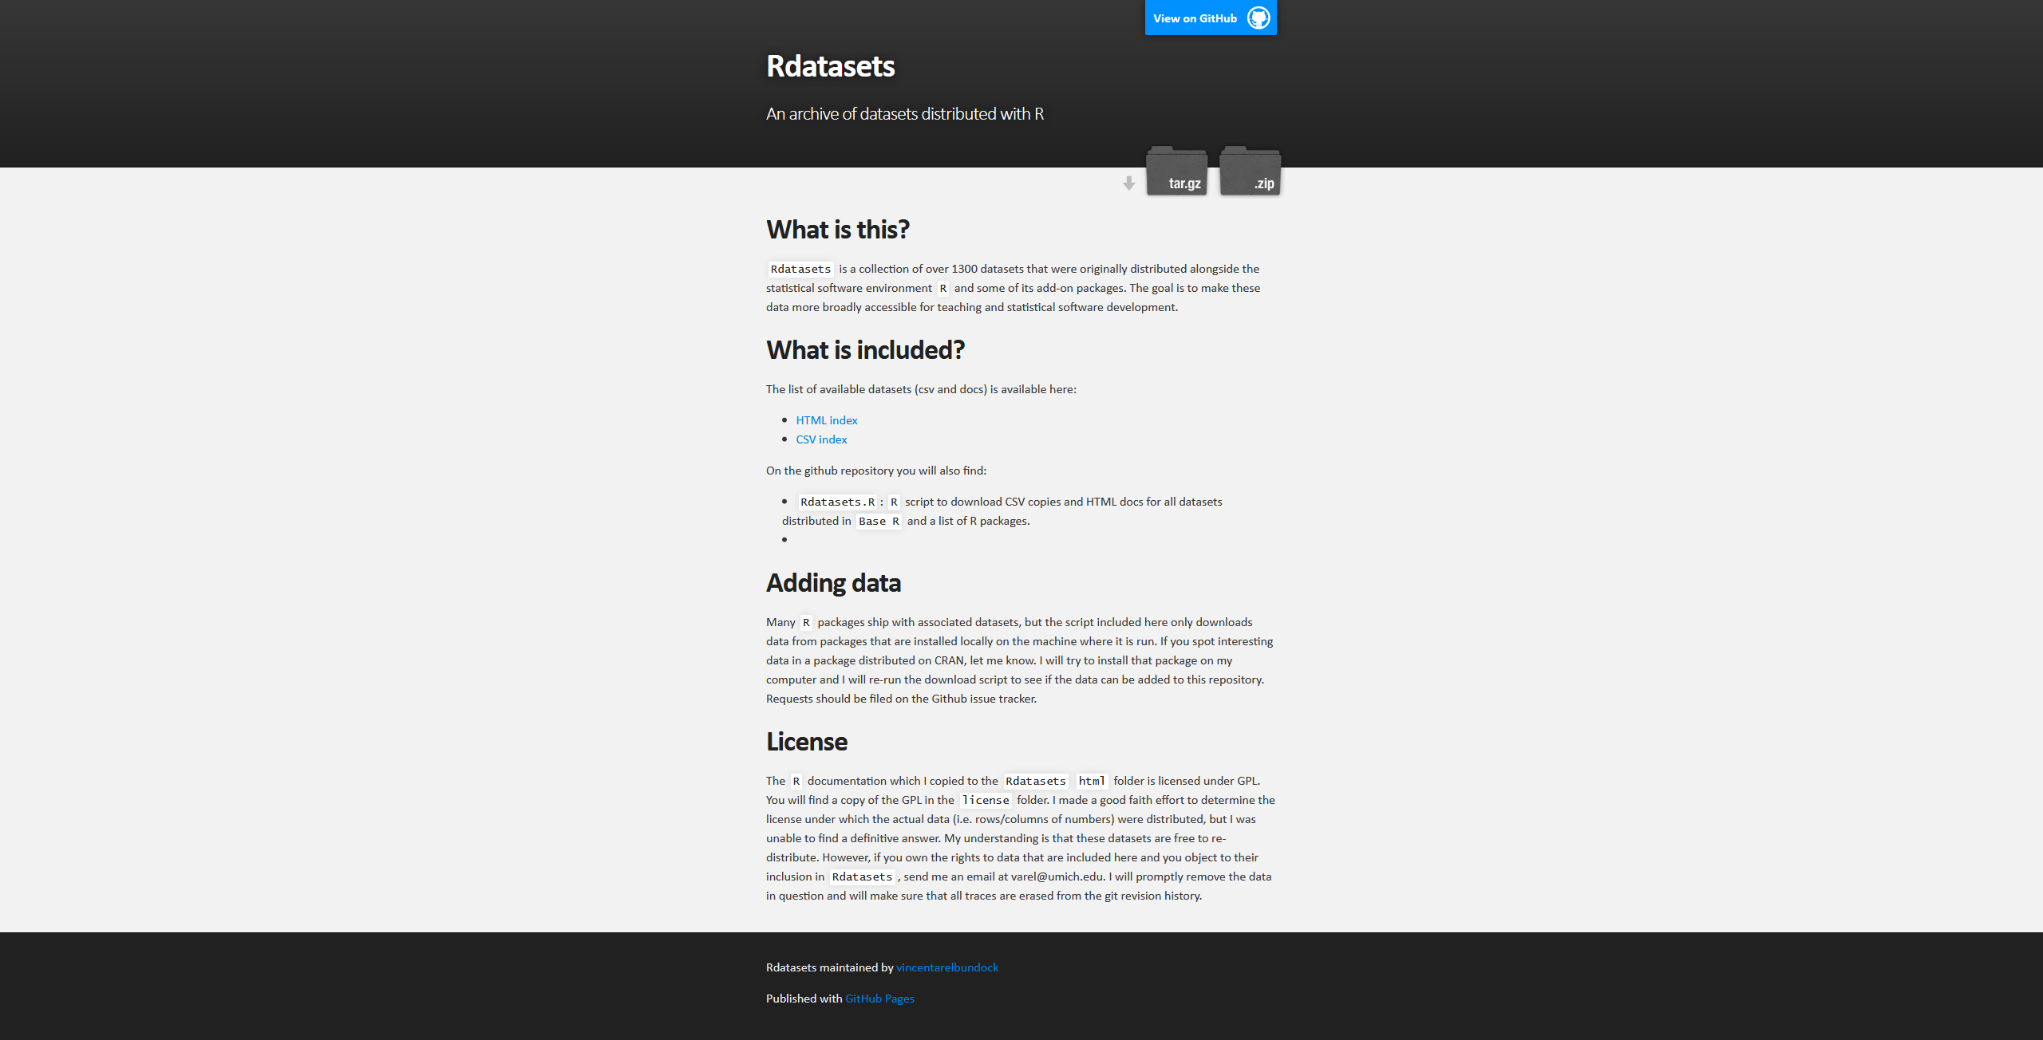
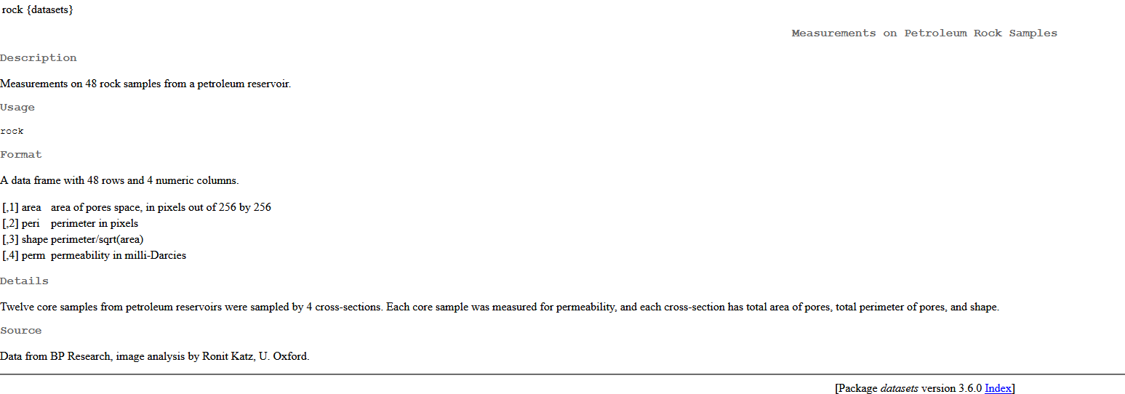
Data Set Source
Courtesy of BP Research and University of Oxford
Publication reference in notebook
Part of R “Datasets” library
https://vincentarelbundock.github.io/Rdatasets/
Description:
https://stat.ethz.ch/R-manual/R-devel/library/datasets/html/rock.html

Slide 4
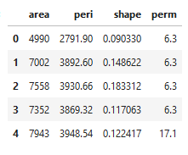
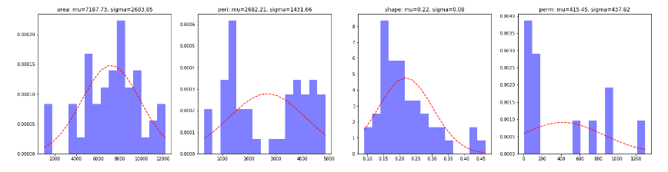
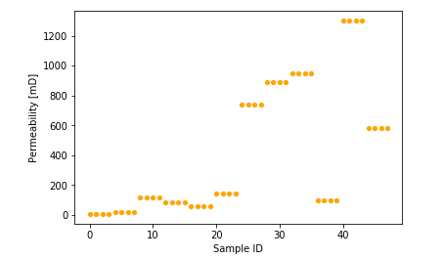
Data Set
Predictors
Area (int): area of pore space, in pixels out of 256x256
Peri (float) perimeter of pores in pixels
Shape (float) perimeter/sqrt(area)
Target
Perm: (float) permeability in milli-Darcies
48 samples from 12 cores
4 features
3 Predictors: Area, Perimeter, Shape
1 Target: Permeability
Shuffling!
Area
Perimeter
Shape
Permeability

Slide 5
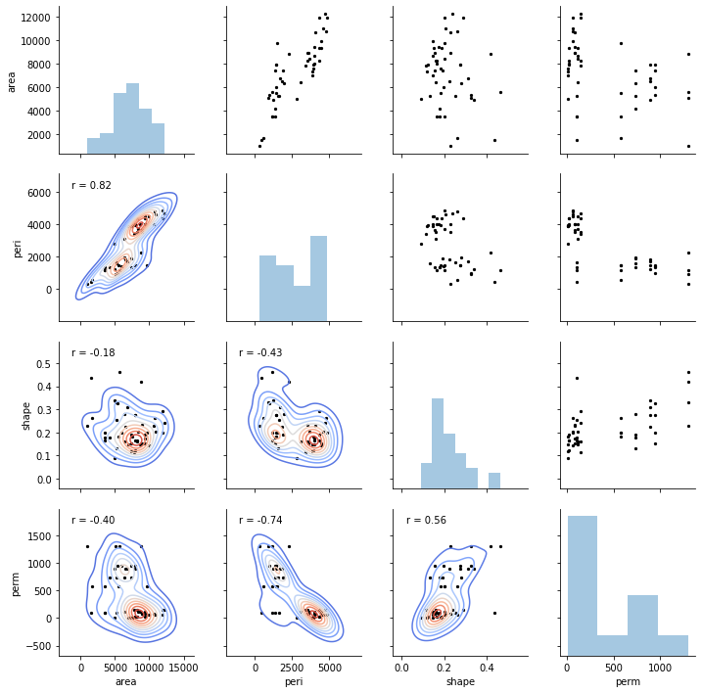
Correlation Plot

Slide 6
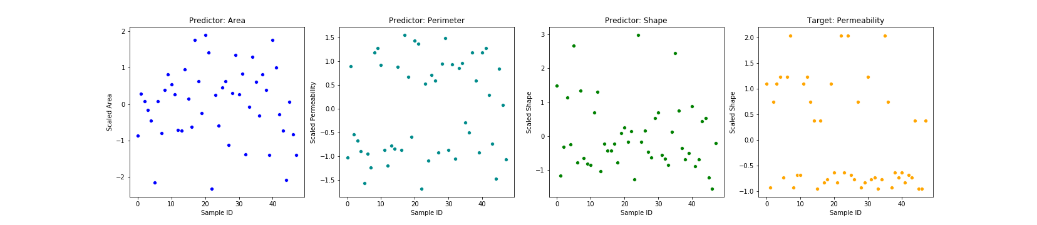
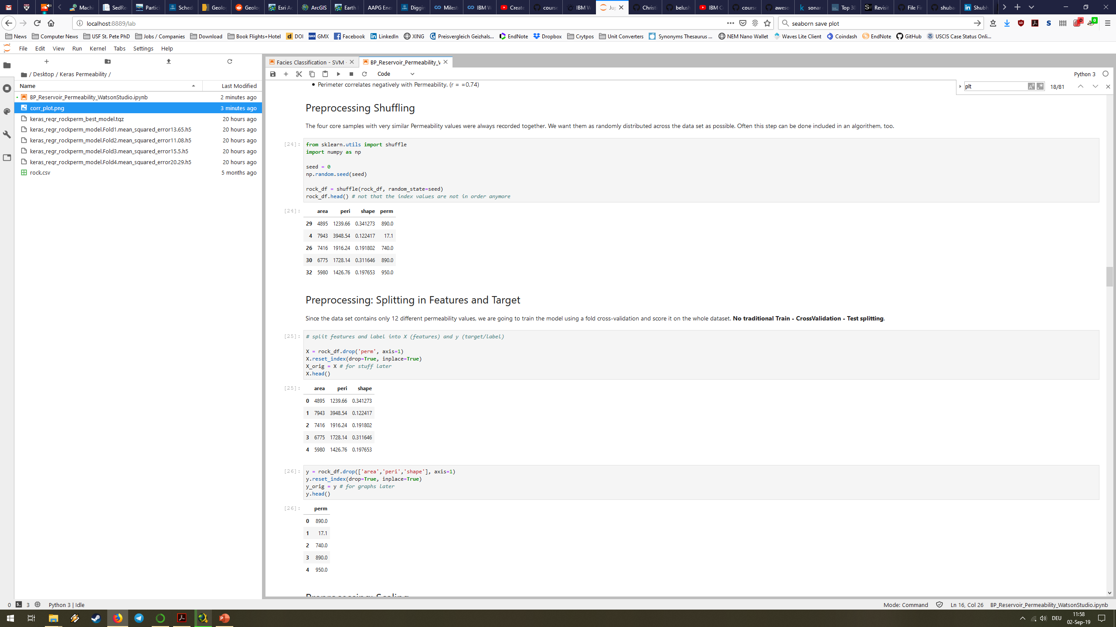
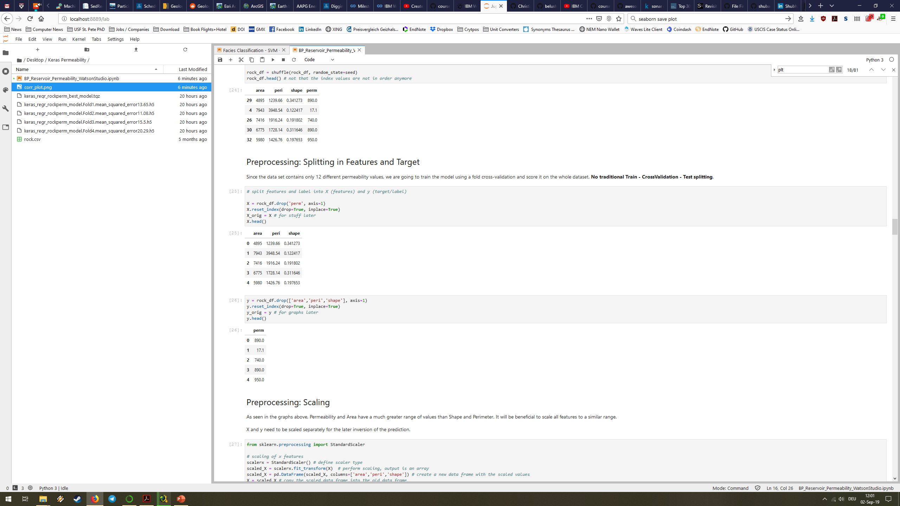
Preprocessing
Input
Shuffling
Splitting
X, y
Scaling
SciKit-Learn
StandardScaler
worked better than
MinMaxScaler
Random seed
for repeatability
Reset index!

Slide 7

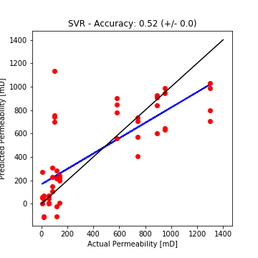

Regression
SystemML (run on Apache Spark)
SciKit-Learn
Algorithm | Optimized for | R2 score
Linear Regression | - | 0.704
Algorithm | Optimized for | R2 score
Support Vector Regression | CV, C penealty param. | 0.525
Decision Tree Regressor | CV, max. depth of tree | 0.428
K-Nearest Neighbor Regressor | CV, K neighbors | 0.419
Linear Regression | CV | 0.401
Random Forest Regressor | CV, estimators | 0.262
Gradient Boosting Regressor | CV | 0.242

Slide 8

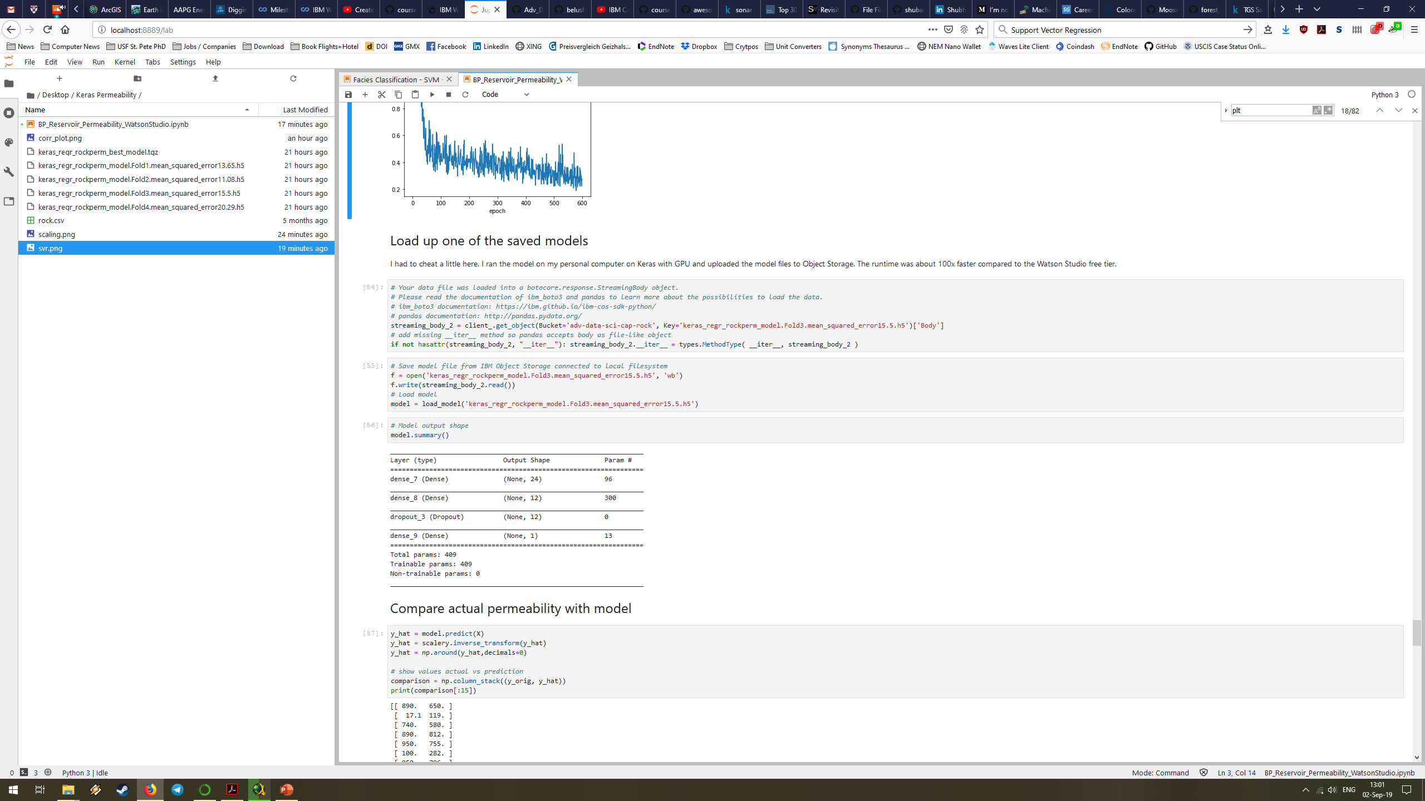
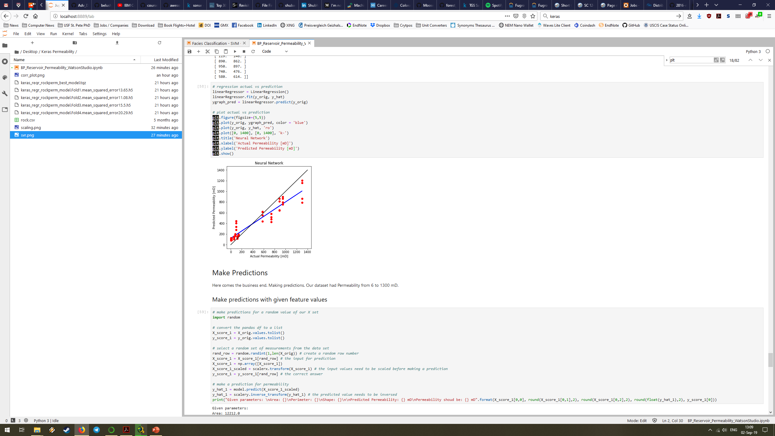
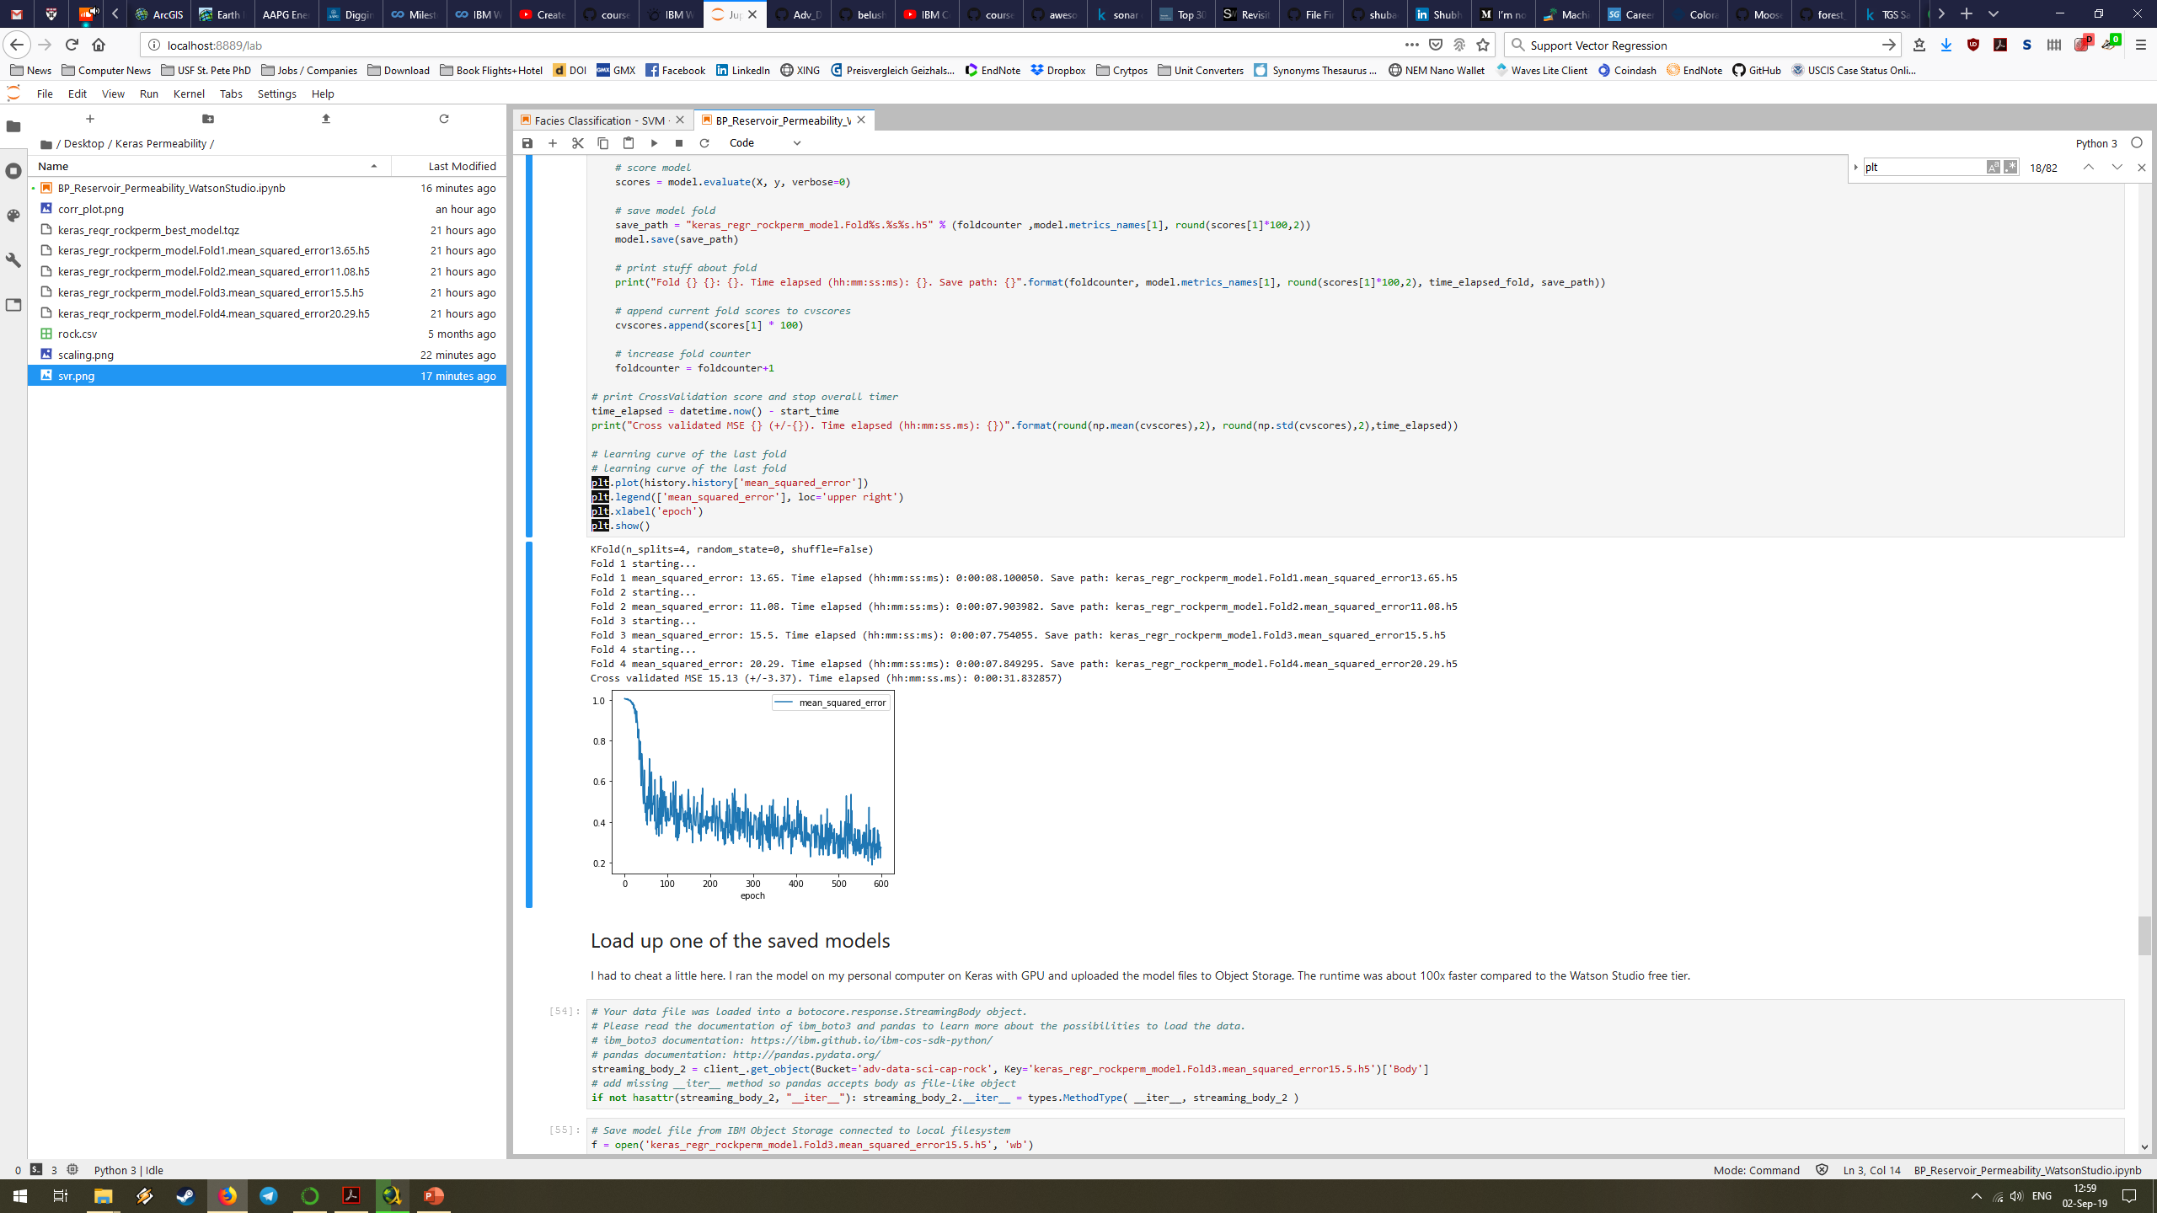
Regression
Keras (Deep Learning) with TF backend
Design:
Dense 24 wide (relu activation)
Dense 12 wide (hidden layer, relu activation)
Dropout (50%) for generalization
Output 1 wide (linear activation)
Settings:
Standard SGD
600 epochs
4 CVs
Results: MSE 15.13 (+/-3.37)
CV 4

Slide 9

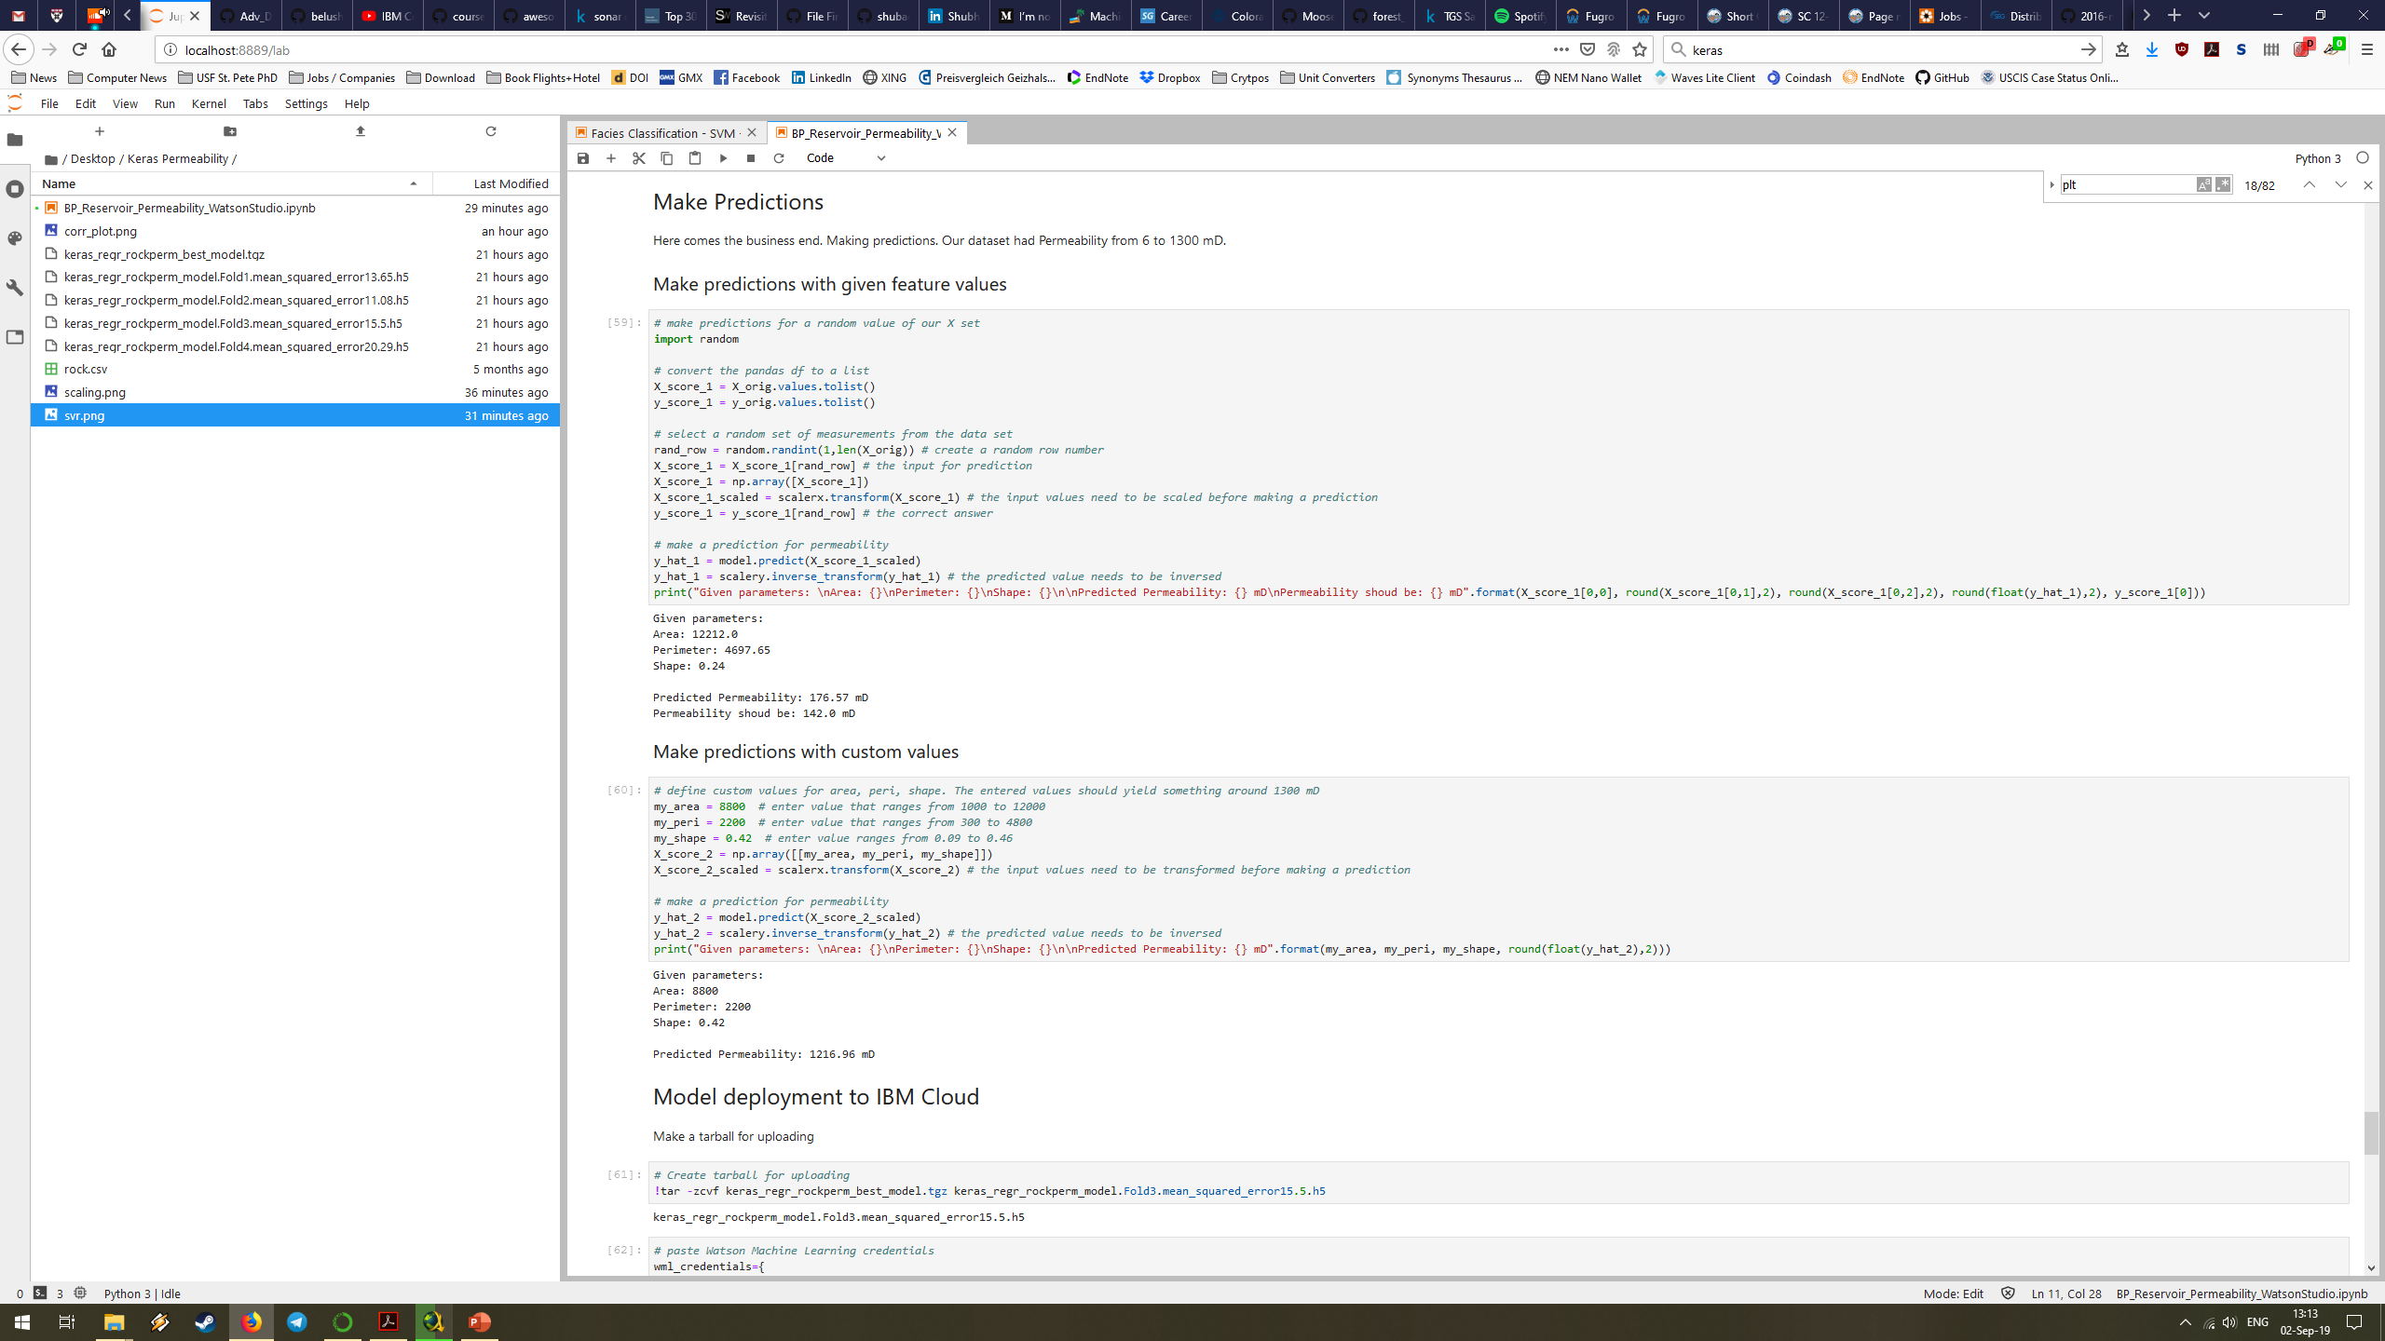
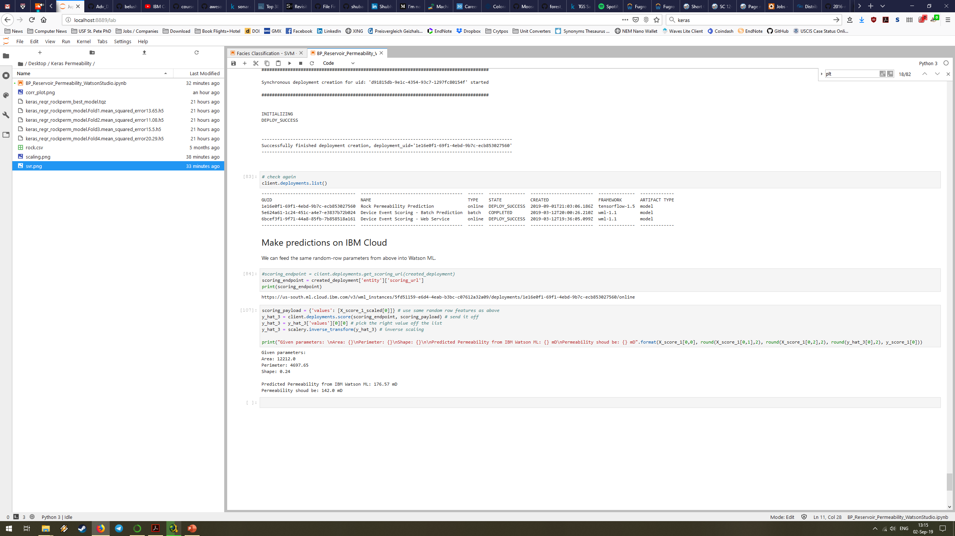
Deep Learning model predictions
In notebook
Deployment on
API prediction

Slide 10
GitHub Repository
https://github.com/ChristianHallerX/Adv_Data_Science_Cap
Thank you.

